Slide 1
Co-Innovation: ​ SAP BTP Generative AI Solution​
Predictive Maintenance for Equipment Failure

Slide 2
USE CASE
NEOMORE AI SOLUTIONS – SIDE-BY-SIDE EXTENSIBILITY
A clean-core architecture for predictive maintenance and guided plant-support workflows.
Relevant data sources
Connect enterprise data, documents, telemetry, and external reference content into one governed retrieval layer.
SAP PM
PDF
IoT
WEB
Plant maintenance data
Equipment documents
Sensor data
Reference content
Equipment
Maintenance orders
Notifications
Measuring points
BoMs
Manuals
Maintenance instructions
Spare-part lists
Temperature & vibration
Pressure & humidity
RPM / speed
Position / proximity
Acoustic signals
Manuals
Instructions
Help pages
Forums & Q&A
BTP extension layer
Standard API access
HANA Vector Engine
HANA database
AI Core + LLM access
Outcome: side-by-side clean-core solution for failure prediction, spare-part demand forecasting, and guided creation of maintenance notifications / orders via standard APIs.

Slide 3
AI Foundation on SAP BTP
Joule
Applications & Extensions
Generative AI Hub
SAP AI Launchpad
Toolset
Playground
Libraries & SDKs
Prompt Engineering
Prompt Management
Prompt Registry*
SAP AI Core
Trust & Control
Inference Engine
Agents*
Multi-tenancy
Security
Content Moderation*
Grounding
Plugins*
Data Privacy
Foundation Model Access
Built by SAP*
Custom
Built by Partners
AVAILABLE
Microsoft Azure OpenAI
Falcon
UPCOMING
Additional foundation models being added
SAP HANA Cloud
Business Data and Context
Vector Engine
Application Data

Slide 4
Use cases for proof of concept ​
Use case 1​
Creating an AI Chatbot for Equipment-Related Inquiries.​
For example : ​
Request failure history of e.g. equipment 7 ( Central Electrical Station ) related to functional location 02-01-01-01-02-01 (Profile straightening line) : data source S/4​
Request information on suitable electrical spare parts for equipment 7 ( Central Electrical Station ) related to functional location 02-01-01-01-02-01 (Profile straightening line . Data sources: BOM from S/4 and equipment manual PDF.​
NB : The equipment manual PDF should be linked to the SAP equipment ID e.g. equipment 7 ( Central Electrical Station ) related to functional location 02-01-01-01-02-01 (Profile straightening line). Additionally, a valid equipment list from Meyer, containing high-quality data (including PDFs, S/4 data, and potential 'ChatGPT'-style insights), is required for the above use case​

Slide 5
Poc Use case 1: Introducing the PoC : Plant-Ops Assistant
Scope
Natural Language Chatbot
Interact with PlantOps Assistant using plain language questions and generic question which can be answered by general knowledge like
“How many shipyards do Meyer Turku have?”
"What is the failure history of Equipment 7?“
AI-Powered Troubleshooting
Integrates SAP Generative AI Hub + CAP LLM plugin
Retrieves context-rich answers from manuals and backend systems
Live SAP Data Access
Connected to S/4HANA using standard SAP APIs:
Maintenance Notification
Maintenance Order
Equipment Details
Functional Location
Document Semantic Search
Upload multiple PDF manuals (we used 5 for the PoC)
Documents vectorized and stored in SAP HANA Cloud Vector Engine
AI retrieves relevant sections using similarity-based semantic search
Multilingual Support
Supports translation of queries and results (e.g., Finnish ↔ English)
Multiple Interface Options
Accessible via SAP Fiori UI or Microsoft Teams bot. Attempt to deploy to Workzone advanced deployment affected the local copy, hence we aborted the process as it may affect the customer demo.
Responsive UI built using SAPUI5 / CAP app router
Document Upload Capability
Easily ingest new equipment manuals into the knowledge base
Scales for various types of PDF documents

Slide 6
Poc Use case 1: Introducing the PoC : Plant-Ops Assistant
Technologies Used
Layer | Technology
Application Logic | SAP Cloud Application Programming Model (CAP)
Development Environment | VS Code
AI Plugin | CAP LLM Plugin (@cap-js/llm)
Embedding & Search | SAP HANA Cloud with Vector Engine
AI Models | SAP AI Core / OpenAI (via Gen AI Hub) Text embedding: text-embedding-ada-002 LLM: gpt-mini-4
RAG implementation | LangChain
Integration | SAP Destination Service, SAP S/4HANA APIs (Neomore’s SAP S4Hana)
Frontend UI | SAPUI5 Swagger UI for API documentation
Deployment | Cloud Foundry via VS code Multi-Target Application (MTA) architecture
Version Control | Git
Repository | GitHub
HTTP Client | SAP Cloud SDK
Testing | Jest and Mocha

Slide 7
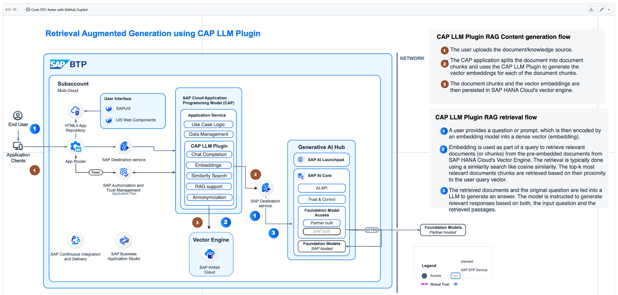
Poc Use case 1: Introducing the PoC : Plant-Ops Assistant Architecture
Architecture

Slide 8
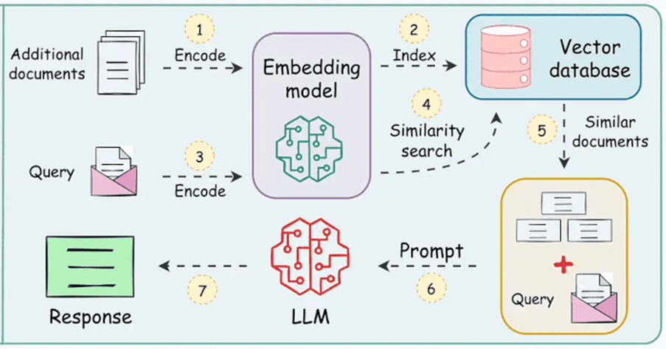
Poc Use case 1: Introducing the PoC : Plant-Ops Assistant
Flow Summary
Document Upload
→ Manual PDFs uploaded and chunked
→ Vector embeddings generated using AI models
→ Stored in SAP HANA Vector Engine
2. User Query Input
→ End user asks a question (e.g., about equipment or manuals)
3. Semantic Search
→ AI plugin retrieves top-k relevant document chunks
→ Also queries S/4HANA live using APIs
4. Generative Response
→ Combines documents + live SAP data
→ Delivers human-like AI response

Slide 9
Let’s watch the DEMO

Slide 10
Poc Use case 1: Introducing the PoC : Plant-Ops Assistant
Future Capabilities on the Roadmap:
AI-powered dashboards for real-time plant health
Multiple Interface Options accessible via SAP Fiori UI or Microsoft Teams bot or Intranet web spaces built on Workzone
Predictive maintenance using time series data from sensors
Fine-tuned industry models specific to equipment types
Continuous Learning from user feedback and SAP logs
Role-based access control for maintenance teams
Mobile Assistant Integration with push notifications
Multi-plant deployments with cross-location knowledge sync
Scalable beyond just Meyer-Graebener context - ready for any plant using SAP.
Why Invest Further?
This PoC shows:
Tangible integration of LLMs, SAP BTP, and Vector AI
Real-world value with document search, live system insight, and AI chat
The foundation is laid - what's needed now are:
Wider document support
Secure multi-user deployment
Broader SAP module integration
With minimal effort, this assistant can become a full-scale smart maintenance solution.

Slide 11
Use cases for proof of concept ​
Use case 2​
Retrieve equipment sensor data and generate a warning notification in S/4​
Warning Notification for scheduled maintenance for equipment as mentioned below :​
• Analyze sensor data trends (e.g., rising temperature over several days) to predict
equipment failure and trigger an S/4 notification for potential breakdown of e.g. equipment 7
( Central Electrical Station ) related to functional location 02-01-01-01-02-01 (Profile
straightening line)​
• Obtain recommended actions for potential issues with e.g. equipment 7 ( Central
Electrical Station ) related to functional location 02-01-01-01-02-01 (Profile straightening
line) based on the PDF maintenance manual or maintenance history in S/4, included in the
long text of SAP Notifications

Slide 12
Thank You!​
We look forward to helping you optimize your maintenance workflows with SAP BTP.

